Slide 1
PROFIT, LOSS & DISCOUNT
LIFE SKILLS –I
COURSE CODE : 18SSK201

Slide 2
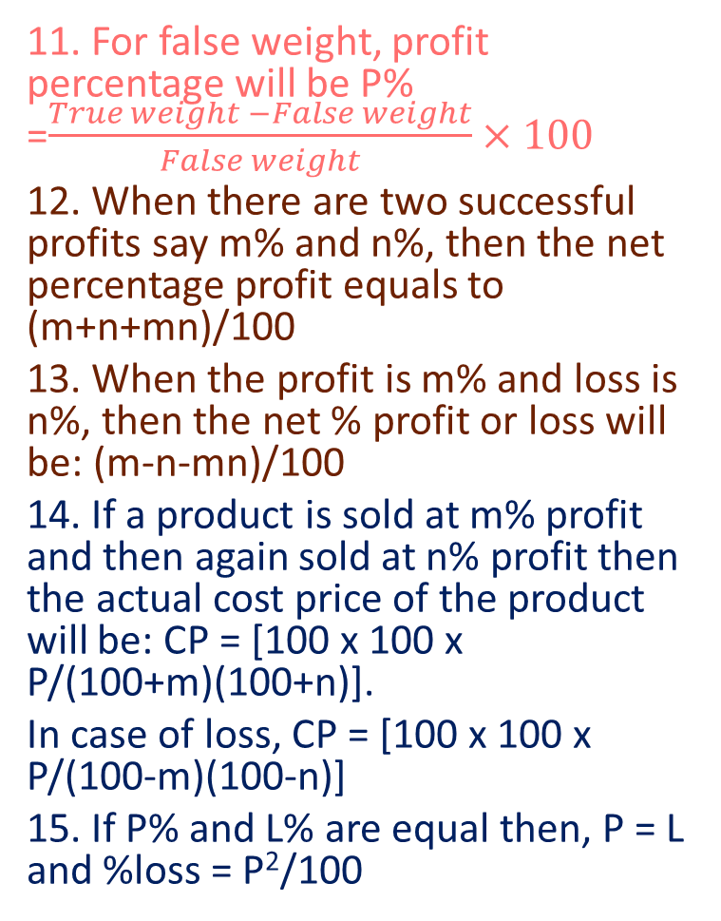
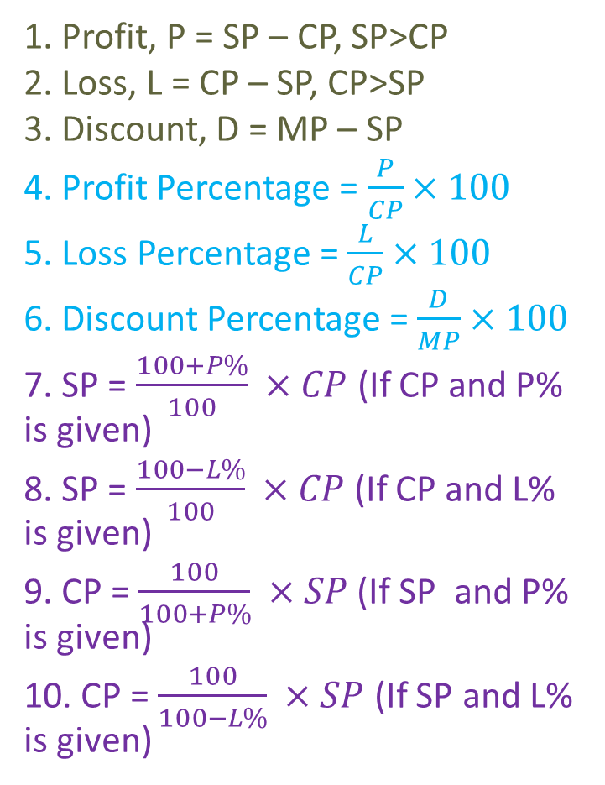
FORMULAS
11. For false weight, profit percentage will be P% =$\frac{True weight −False weight}{False weight}×100$
12. When there are two successful profits say m% and n%, then the net percentage profit equals to (m+n+mn)/100
13. When the profit is m% and loss is n%, then the net % profit or loss will be: (m-n-mn)/100
14. If a product is sold at m% profit and then again sold at n% profit then the actual cost price of the product will be: CP = [100 x 100 x P/(100+m)(100+n)].
In case of loss, CP = [100 x 100 x P/(100-m)(100-n)]
15. If P% and L% are equal then, P = L and %loss = P²/100
1. Profit, P = SP – CP, SP>CP
2. Loss, L = CP – SP, CP>SP
3. Discount, D = MP – SP
4. Profit Percentage = $\frac{P}{CP}×100$
5. Loss Percentage = $\frac{L}{CP}×100$
6. Discount Percentage = $\frac{D}{MP}×100$
7. SP = $\frac{100+P\%}{100} ×CP$(If CP and P% is given)
8. SP = $\frac{100−L\%}{100} ×CP$(If CP and L% is given)
9. CP = $\frac{100}{100+P\%} ×SP$ (If SP and P% is given)
10. CP = $\frac{100}{100−L\%} ×SP$ (If SP and L% is given)

Slide 3
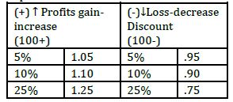
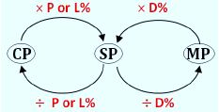
APPLICATION OF PERCENTAGE TO PROFIT AND LOSS
TWO – STEP PROCESS
Step 1 : Always write Percentage (%) terms in decimals
(see table below)
For profits add into 100 while for loss minus from 100
STEP2 – If you have to calculate SP always multiply P
(decimal) with SP
P = profit
L =Loss
D = discount

Slide 4
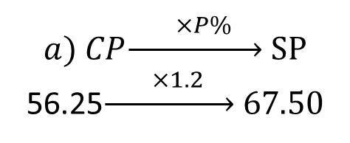


problEms
Solution :
a) SP = $\frac{100+P\%}{100}×CP$
SP = $\frac{120}{100}×56.25=67.5$
b) SP = $\frac{85}{100}×80.40$
SP = 68.34
Find S.P when
a) C.P = Rs. 56.25, Gain = 20% b) C.P = Rs. 80.40, Loss = 15%
$$a) CP\underset{→}{ ×P\% } SP$$
56.25$\underset{→}{ ×1.2 } 67.50$
OR
b) $CP\underset{→}{ ×L\% } SP$
80.40$\underset{→}{ ×0.85 } 68.34$
OR

Slide 5

Solution :
If he sells 100 candies in 5 Rupees; in 1 Re he sells 20 candies. Selling Price = Re. 1
SP = $\frac{100+P\%}{100}×CP$
1 = $\frac{120}{100}×CP$
CP = Rs. 5/6
If 20 candies are bought for Rs. 5/6
20 5/6 (CP)
? 1 (CP)
$\frac{5}{6}x=20$
X = 24.
A hawker sells 100 candies for 5 Rupees. If he manages to makes a profit of 20%, how many candies did he buy for a rupee?

Slide 6
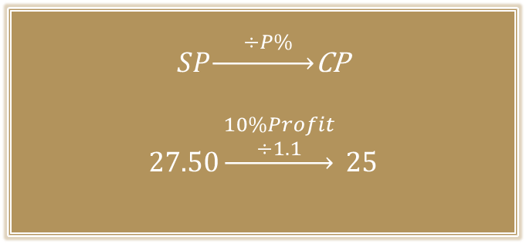

A book was sold for Rs. 27.50 with a profit of 10%. If it were sold for Rs. 25.75, then what would have been the percentage of profit or loss?
Solution :
Given, SP = 27.50, Profit % = 10%
CP = $\frac{100}{110}×27.50$ = 25
SP = 25.75
Profit% = $\frac{Profit}{CP}×100$
Profit % = $\frac{0.75}{25}×100$
= 3%
$SP\underset{→}{ ÷P\% }$CP
$$27.50\underset{→}{\begin{aligned}10\%Profit \\ ÷1.1\end{aligned}} 25$$
OR

Slide 7

Solution :
CP 6 B Rs. 10
SP 4 B Rs. 6
To find the gain or loss percent, Make equal no. of bananas
LCM (6,4) = 12
CP 12 B Rs. 20 (10 × 2)
SP 12 B Rs. 18 (6 × 3)
Since CP>SP, Loss of Rs. 2
Loss % = $\frac{2}{20}×100$
= 10%
A vendor bought bananas at 6 for Rs. 10 and sold them at 4 for Rs. 6. Find his gain or loss percent.

Slide 8


Solution:
Given, SP = Rs. 960, Loss = 4%.
CP = $\frac{100}{100−L\%} ×SP$
CP = $\frac{100}{96}×960$
CP = 1000
CP = 1000, with profit % = 16
SP = $\frac{100+P\%}{100} ×CP$
SP = $\frac{116}{100}×1000$
= Rs. 1160
By selling a casserole for Rs. 960, a man incurs a loss of 4%. At what price should he sell the casserole to gain 16%?
$$SP\underset{→}{÷L\% }CP$$
$$\left(SP\right)960\underset{→}{ ÷0.96 }1000\left(CP\right)$$
CP = 1000, Profit% = 16
C$P\underset{→}{×P\% }SP$
$$\left(CP\right)1000\underset{→}{ ×1.16 }1160\left(SP\right)$$
OR

Slide 9


Solution :
Let CP be Rs. 100
Gain = 25%
SP = 100 + 25% of 100 = 125
Suppose CP = Rs. 80
Gain 30%,
SP =$\frac{130}{100}×80$ = 104
Difference = 125-104 = 21
100 21
? (x) 10.50
X = $\frac{100×10.5}{21}=50Rs.$
A man sells an article at a profit of 25%. If he had bought it at 20% less and sold it for Rs. 10.50 less, he would have gained 30%. Find the cost price of the article.
$$CP\underset{→}{ ×P\% }SP$$
$$100\underset{→}{ ×1.25 }125$$
$$80\underset{→}{ ×1.30 }104$$
Difference = 21
100 21
?(x) 10.50
X = $\frac{100×10.5}{21}=50Rs$
OR

Slide 10
Solution :
Let us assume the CP of one TV = Rs. 1000
CP of 2 TV’s = Rs. 2000
One is at a profit of 20%, SP = CP + Profit
SP = 1000 + 20% of 1000 = 1200
One is at a loss of 20%, SP = CP – loss
SP = 1000-20% of 1000 = Rs. 800
Total SP = 1200 + 800 = 2000
Since CP = SP,
There is neither profit nor loss.
Two TV sets are bought at the same price. One is sold at 20% profit and the other is sold at 20% loss. Find the overall profit/loss percentage made in the transaction.

Slide 11
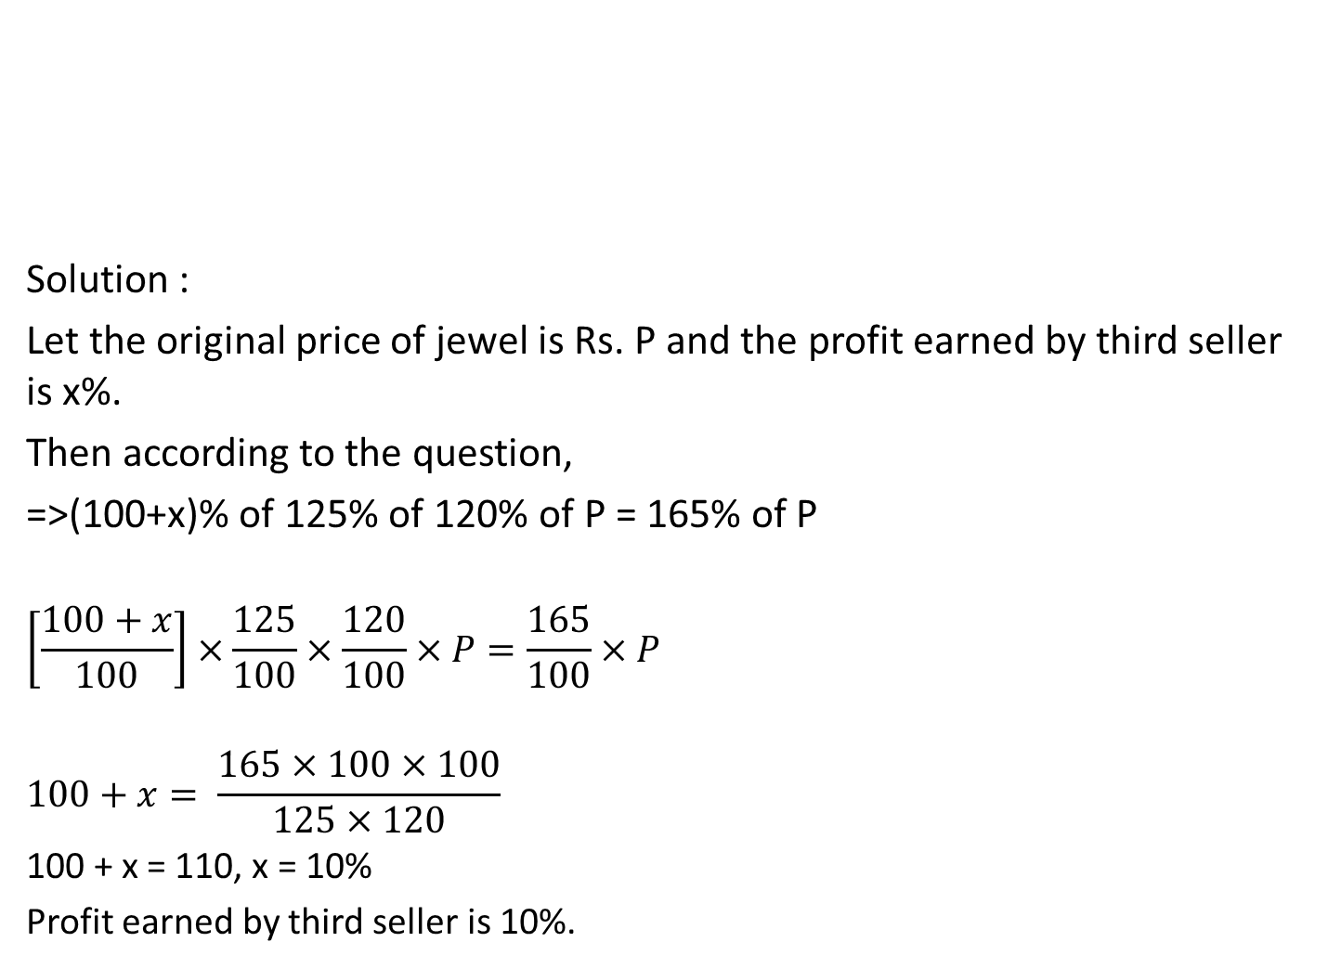
Solution :
Let the original price of jewel is Rs. P and the profit earned by third seller is x%.
Then according to the question,
=>(100+x)% of 125% of 120% of P = 165% of P
$$\left[\frac{100+x}{100}\right]×\frac{125}{100}×\frac{120}{100}×P=\frac{165}{100}×P$$
$$100+x= \frac{165×100×100}{125×120}$$
100 + x = 110, x = 10%
Profit earned by third seller is 10%.
The price of a jewel, passing through three hands, rises on the whole by 65%. If the first and the second seller earned 20% and 25% profit respectively, find the percentage profit earned by the third seller?

Slide 12


After getting two successive discounts, a shirt with a list price of Rs. 150 is available at Rs. 105. If the second discount is 12.5%, find the first discount.
Solution :
Let the two discounts be x% and 12.5%.
$$150×\frac{100−x}{100}×\frac{100−12.5}{100}=105$$
$$100−x=\frac{105×100×100}{87.5×150}$$
100-x = 80
x = 20%
$$MP\underset{→}{ ×D\% } SP$$
$$150\underset{→}{ ×0.875 } 131.25$$
SP = 105
Difference = 131.25-105 = 26.25
Discount% = $\frac{26.25}{131.25}×100$
=20%
OR

Slide 13


Solution :
Normal Method :
Let the CP be Rs. 100
SP = 100 + 33% of 100 = 133
MP=$\frac{100}{100−discount\%}×SP$
MP = $\frac{100}{95}×133$ = 140
Since MP>CP,
% increase = $\frac{MP−CP}{CP}×100$
=$\frac{140−100}{100}×100$
= 40%
At what percentage above the CP must an article be marked so as to gain 33% after allowing a customer a discount of 5%?
Cost price : Marked Price
100-Discount% : 100 + Profit%
100-5% : 100 + 33%
95 : 133
38
Required % = $\frac{38}{95}×100$
= 40%
OR

Slide 14

Solution :
Given, profit = 20%, Difference between SP and CP = Rs. 240
$$Profit\%= \frac{SP−CP}{CP}×100$$
$$20=\frac{240}{CP}×100$$
CP = 120 × 100 = 1200
Therefore, SP = 1200 + 240 [Because SP – CP = 240]
SP = 1440.
The difference between the cost price and sale price of an article is Rs. 240. If the profit is 20%, the selling price is

Slide 15

Solution :
Given, 20CP = XSP
$\frac{CP}{SP}=\frac{X}{20}$ 20-X (Profit)
Profit% = $\frac{20−X}{X}×100$
25 = $\frac{20−X}{X}×100$
25X = 2000 – 100X
125X = 2000
X = 16.
The cost price of 20 articles is the same as the selling price of x articles. If the profit is 25%, then the value of x is

Slide 16
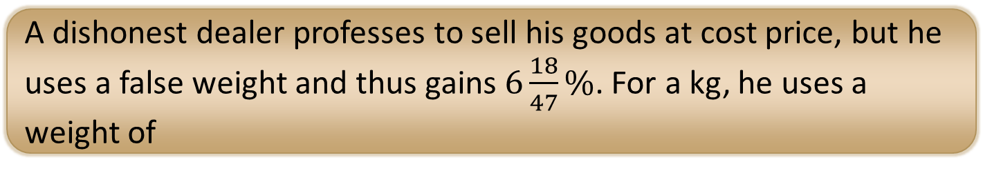

Solution :
Given, Gain % = $6\frac{18}{47}\%= \frac{300}{47}$
P% =$\frac{True weight −False weight}{False weight}×100$
For 1 Kg,
$$\frac{300}{47}=\left(\frac{1−FW}{FW}\right)×100$$
$$\frac{1}{FW}−1= \frac{3}{47}$$
$$\frac{1}{FW}= \frac{3}{47}+1= \frac{50}{47}$$
FW = 47/50
FW = 47000/50 = 940 grams.
A dishonest dealer professes to sell his goods at cost price, but he uses a false weight and thus gains $6\frac{18}{47}\%$. For a kg, he uses a weight of

Slide 17
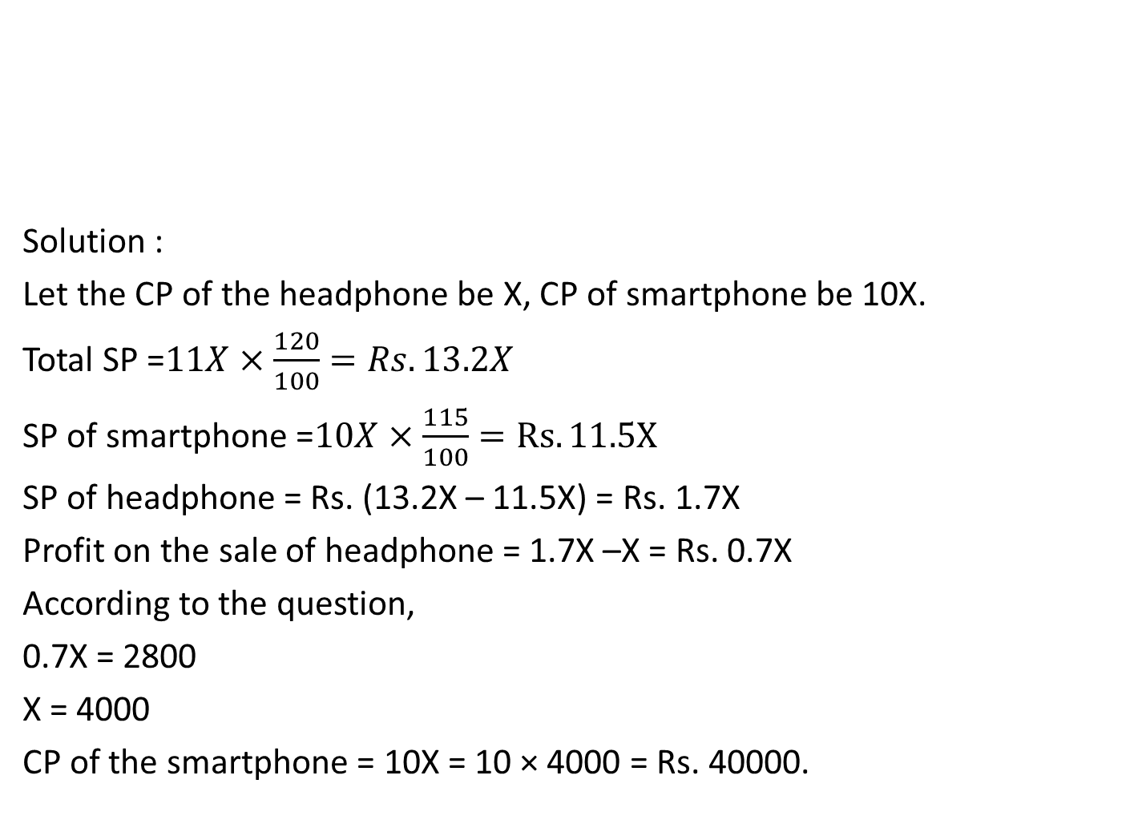
Solution :
Let the CP of the headphone be X, CP of smartphone be 10X.
Total SP =$11X×\frac{120}{100}=Rs. 13.2X$
SP of smartphone =$10X×\frac{115}{100}=Rs. 11.5X$
SP of headphone = Rs. (13.2X – 11.5X) = Rs. 1.7X
Profit on the sale of headphone = 1.7X –X = Rs. 0.7X
According to the question,
0.7X = 2800
X = 4000
CP of the smartphone = 10X = 10 × 4000 = Rs. 40000.
A smartphone costs 10 times the cost of a headphone. On selling smartphone there is a profit of 15% while the total profit on selling both headphone and smartphone is 20%. If there is a profit of Rs. 2800 on selling headphone then find the cost price of smartphone?

Slide 18


Marked price of three articles A, B and C are Rs.2400, Rs.3000 and Rs.3600 respectively. A is sold at a discount of 5%, B at a discount of 8% and C at a discount of 10%, yet the shopkeeper got a overall profit of 20%. If cost price of A is half of B and the cost price of B is half of C, find the cost price of C?
Solution :
MP of A = Rs. 2400
SP of A = $2400×\frac{95}{100}=Rs. 2280$
MP of B = Rs. 3000
SP of B = $3000×\frac{92}{100}=Rs. 2760$
MP of C = Rs. 3600
SP of C = $3600×\frac{90}{100}=Rs. 3240$
Total SP = Rs. (2280+2760+3240)
= Rs. 8280
Total CP $×\frac{120}{100}=8280$
Total CP = 8280$×\frac{10}{12}=Rs. 6900$
Let, CP of A = x, CP of B = 2x, CP of C = 4x
4x + 2x + x = 6900
7x = 6900
X= 6900/7
CP of C= 4x = $4×\frac{6900}{7}$
=Rs. 3942.85

Slide 19


